Slide 1
Natural Gas Price Volatility
A Market Risk & Trading Exposure Case Study
Analyzing 20+ years of Henry Hub pricing data to uncover volatility patterns, seasonal risk, and trading implications.
Jocelyn Beavers | Expand Energy - Middle Office Analyst Candidate

Slide 2
The Problem
Why Natural Gas Prices Volatility Require Constant Analysis
Energy Demand Surge
Trading Risks
Operational Risk
The rapid growth of AI, cloud computing, and hyperscale data centers is exploding energy demand. These massive facilities require constant electricity, which often comes from natural gas
Natural gas prices can swing 40% in a single month. Without visibility into volatility patterns trading can face unmanaged market to market losses.
Risk, credit and trade control functions depend on accurate, timely market data to monitor counterparty exposure and enforce position limits.
Notes:
The rapid growth of AI, cloud computing, and hyperscale data centers is exploding energy demand. These massive facilities require constant electricity, which often comes from natural gas. Understanding price volatility is critical for companies to manage energy supply, trading exposure, and operational risk.

Slide 3
The Approach
How the analysis was structured and completed.
Data Sources
Analytical Process
U.S EIA – Henry Hub Natural Gas Spot Price data & monthly data, 2000-2024 (20+ years)
Coverage: 6k + Daily Observations Format: CSV -> SQL -> Excel -> Tableau
Extract -Downloaded EIA Henry Hub spot price dataset
Clean - Removed nulls, standardized dates, validated ranges in MySQL
Analyze - Calculated monthly average, rolling volatility and YoY change in Excel
Visualize - Build Tableau visualizations and Excel Pivot Tables

Slide 4
Key Findings
Patterns, anomalies and implications for trading risk
40%+
Peak monthly price swing
#1 Driver
Winter heating demand
Most volatile years so far:
2005 & 2022
20+ years
of oil pricing cycles analyzed
Winter months consistently show the highest price volatility due to heating demand and storage withdrawals
Price spikes correlate strongly with cold snaps, supply disruptions and storage inventory shortfalls
Post 2020 energy transition dynamics introduced new structured volatility - LNG exports created tighter domestic supply
Rolling 30-day volatility is a reliable leading indicator for period of elevated trading risk.

Slide 5
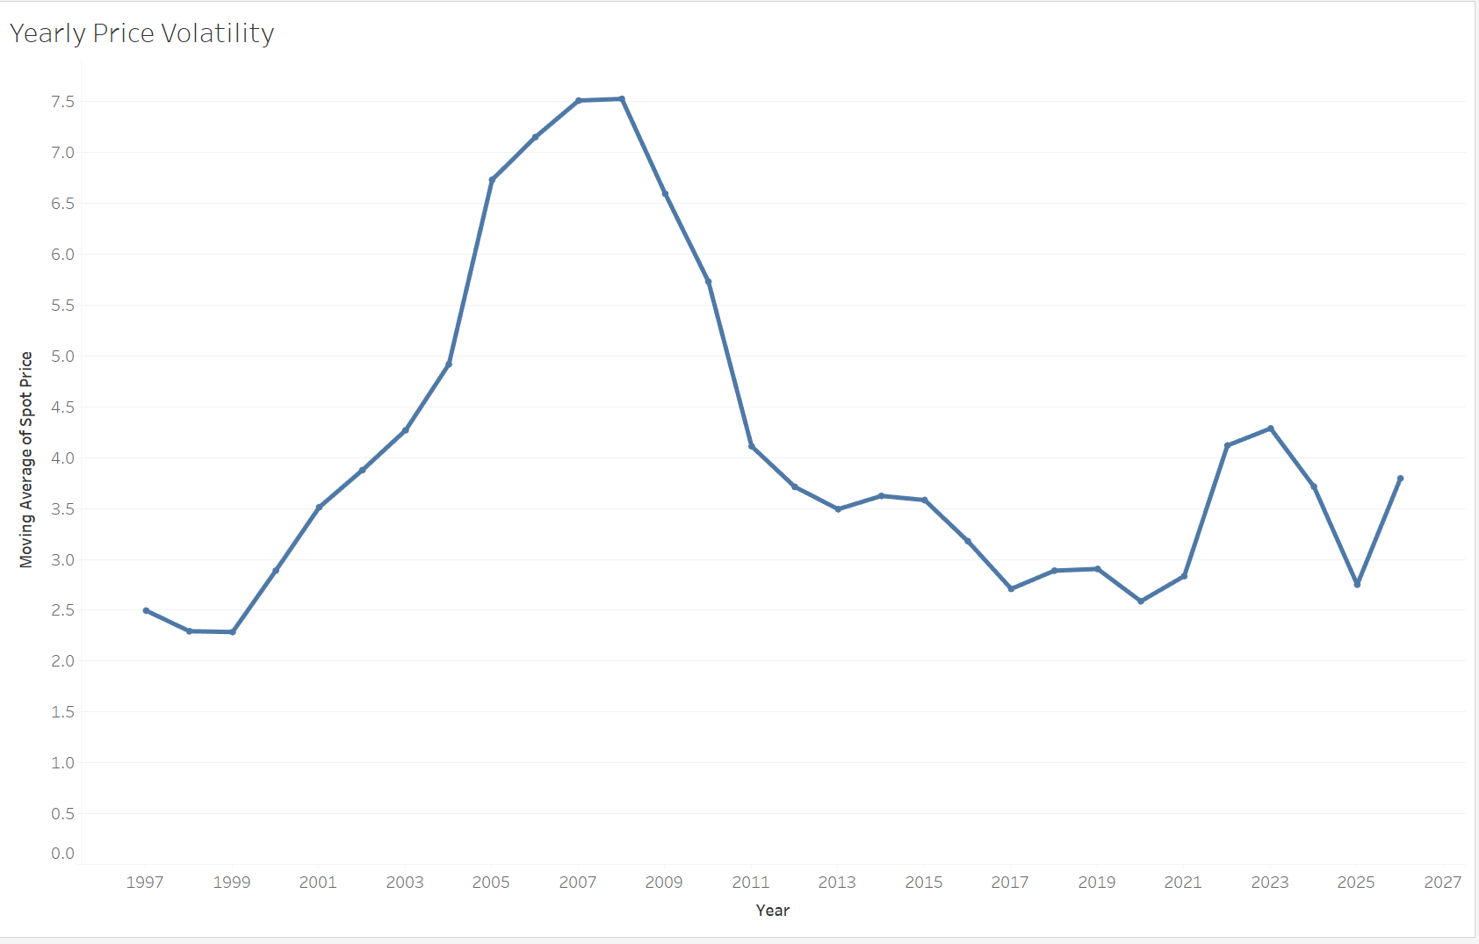
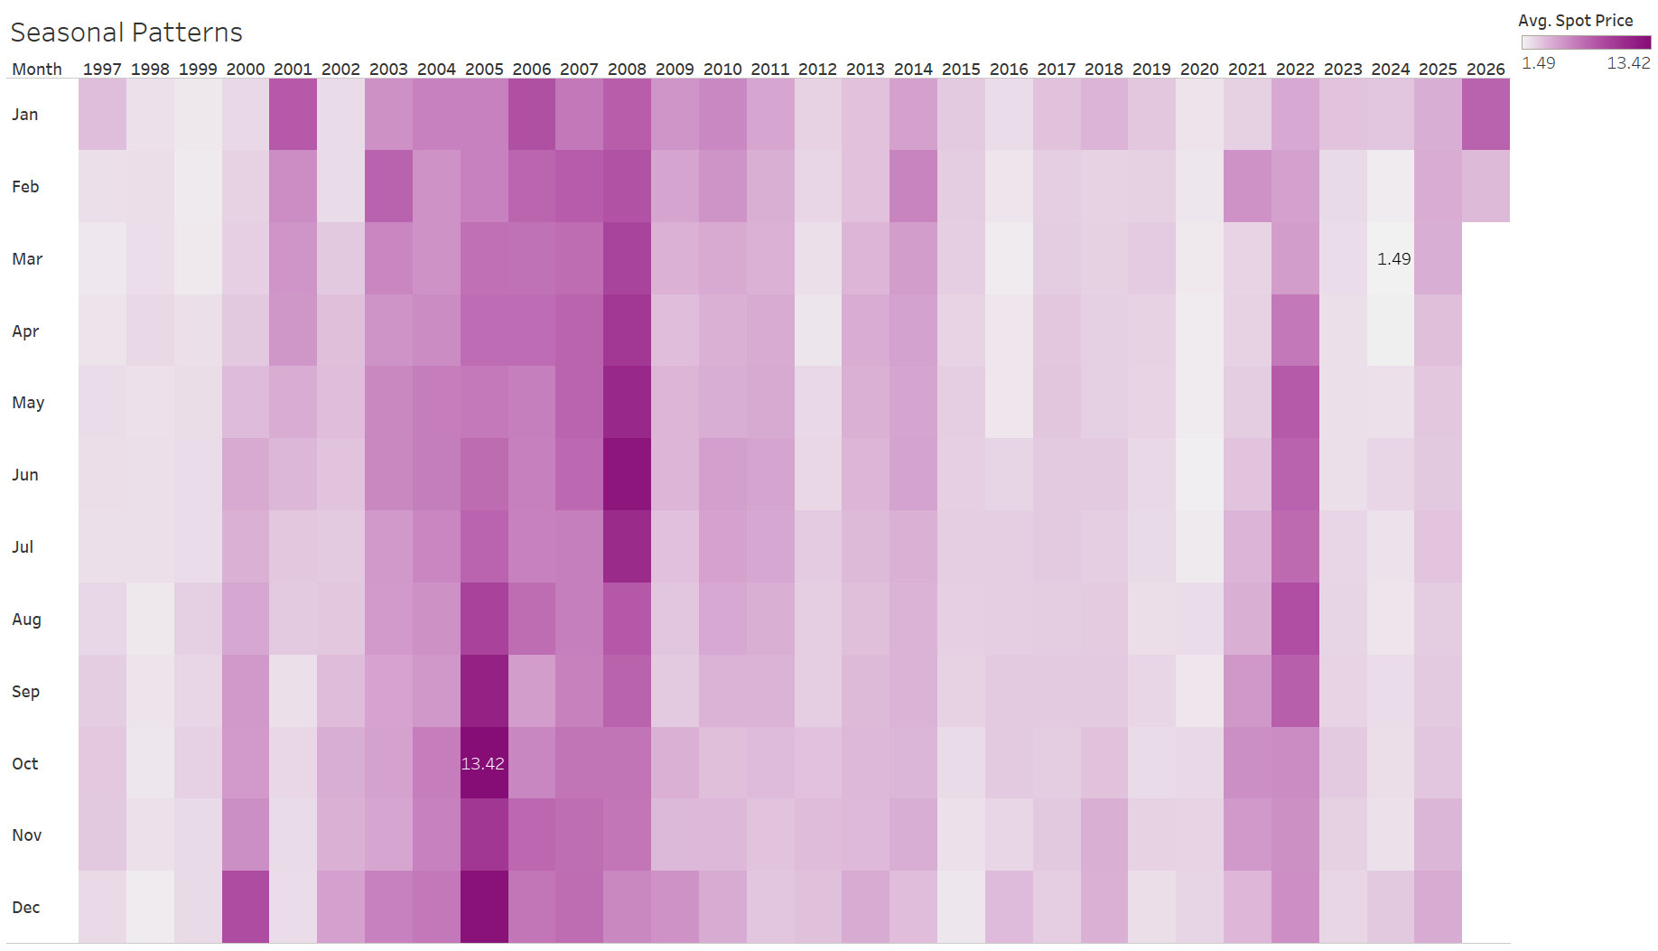
Tableau Visual Analysis

Slide 6
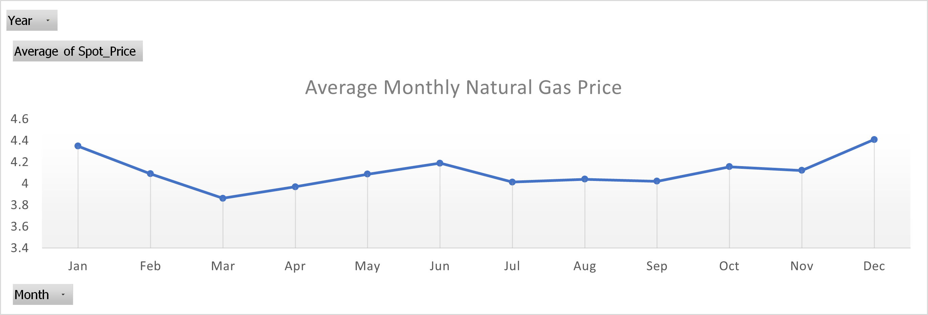
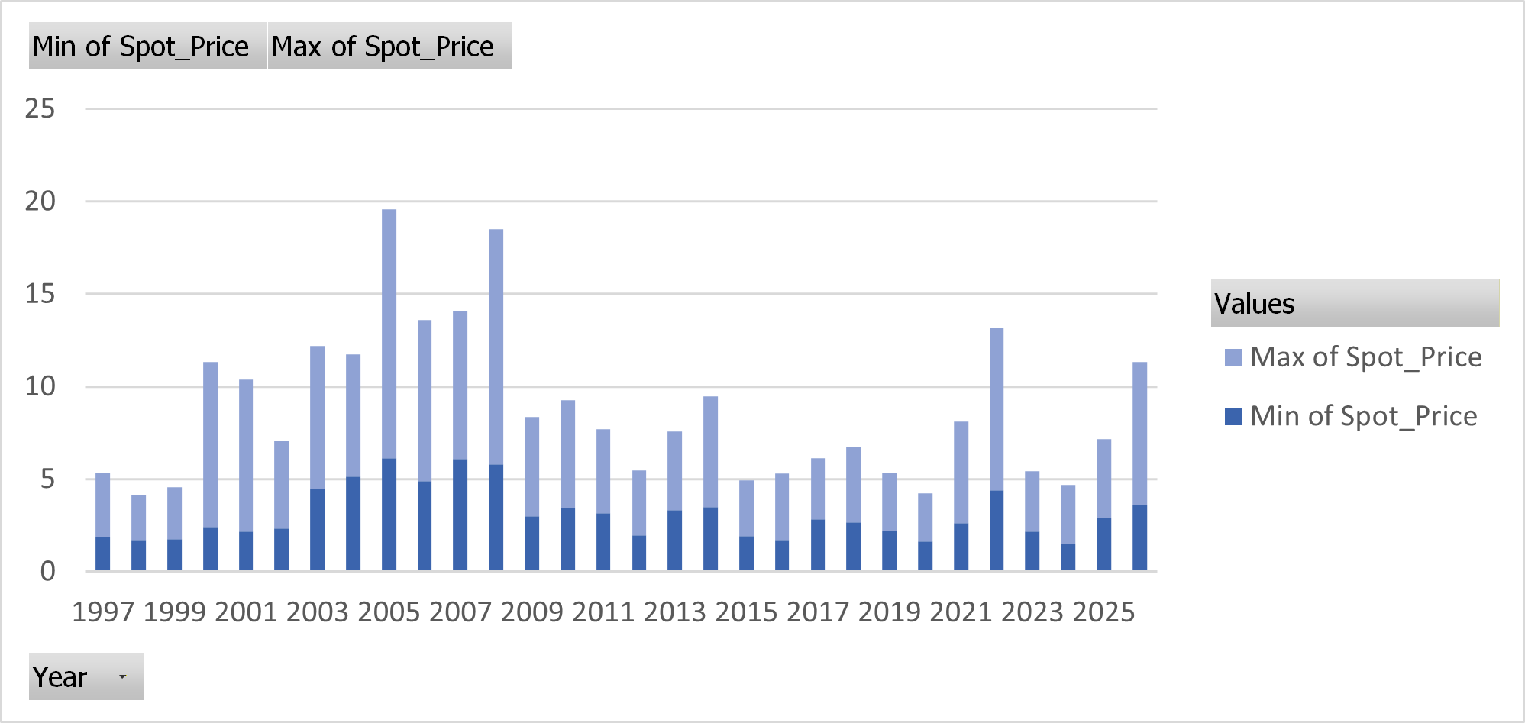
Pivot Tables

Slide 7
Translating market analysis into risk management action
This Analysis enabled:
Skills demonstrated:
Daily risk reports flagging high-volatility periods
Market to market exposure tracking against price moves
Seasonal position limit recommendations for trading
Counterparty stress-testing during volatile periods
SQL – data extraction, cleaning and transformation
Excel – pivot analysis, trend modeling
Tableau – interactive risk dashboard
EIA data fluency – understanding energy data
Full Dashboard: Tableau Public | SQL & methodology: GitHub | jocelynland11@gmail.com

